Slide 1
TICKETLESS ENTRY SYSTEM IN MUSEUM
TEAM-SOFTWARE CHASERS

Slide 2
ABOUT PROBLEM
MINISTRY AND ORGANIZATION – MINISTRY OF CULTURE
PROBLEM STATEMENT – E-TICKET ENTRY SYSTEM IN MUSEUM
TEAM NAME - SOFTWARE CHASERS
TEAM MEMBER – GAJENDRA , ANIRUDH , AYUSH , ASHUTOSH
DEPARTMENT – COMPUTER SCIENCE AND ENGINEERING

Slide 3

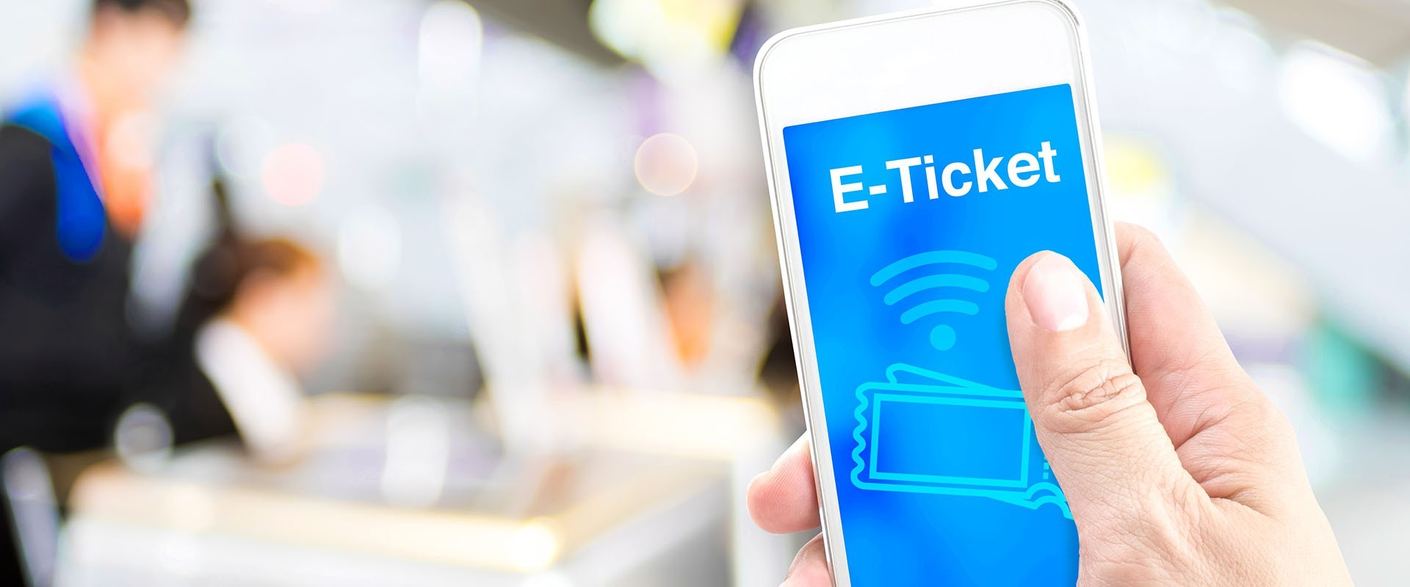


OBJECTIVE
IT REDUCE BOOKING EXPENSES BY ELIMINATING NEED FOR
PRINTING AND MAILING PAPER DOCUMENTS.
CAN HELP TO KEEPING BETTER RECORD OF VISITORS.
IMPROVE SALES AS A VISTOR CAN BOOK, PURCHASE AND PRINT OUT E-TICKET ANY TIME IN 24 HOURS.
PREDICT THE EXPECTED CROWD
SERVICE BOOKING FOR PHYSICALLY HANDICAPPED PEOPLE

Slide 4

SOLUTION
Visitor coming on login page, put his/her general information and reach main interface of the website.
On the main interface, the visitor puts his/her visiting details.
After this, the visitor gets to the payment gateway (UPI/CREDIT CARD ETC).
After successful payment, an LINK share in SMS form to the visitor’s device.
After click on it an E-ticket with QR code will be generated
When the user reach at the venue, the QR code will be checked by the guard on duty and the visitors can be able to visit the place

Slide 5



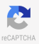




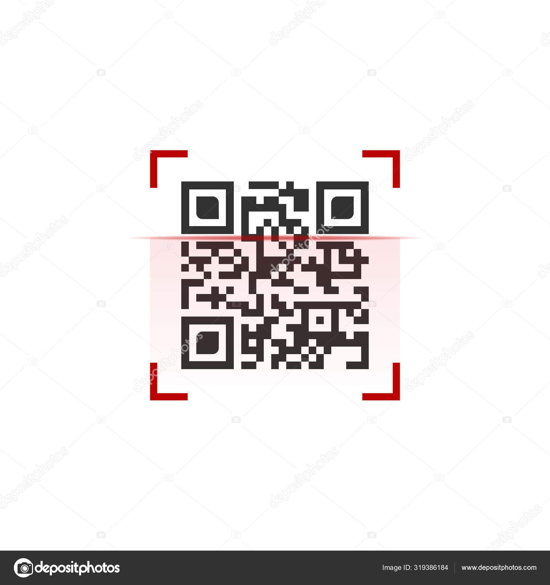
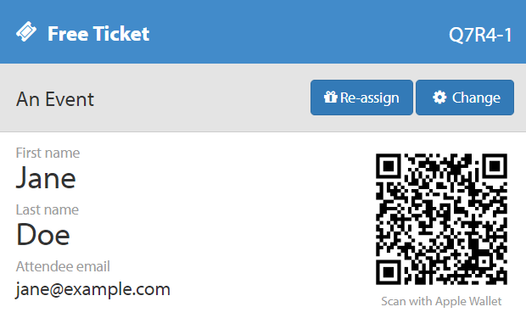
USER CASE
USERNAME, EMAIL, MOBILE NO, PASSWORD
SIGN UP
LOGIN
MAIN INTERFACE
PAYMENT GATEWAY
E-TICKET
CHECK IN
EMAIL, PASSWORD
OTP GENERATED ON GIVEN EMAIL/PHONE
FACILITIES, TIME SLOT, NUMBER OF VISITORS, ID CARD
USER/VISITOR
DATABASE
BOOKING REFERENCE ID
INTERNET BANKING / UPI
WITH QR CODE
GUARD CHECKS THE QR CODE

Slide 6
TECHNOLOGY
FOR FRONTEND - HTML, CSS, JAVASCRIPT
FOR BACKEND- PYTHON
FOR DATABASE - MYSQL
FUTURE WORK
GPS TRACKING SERVICE TO PROVIDE MORE COMFORT AND SERVICES TO USER
ADD VIRTUAL ASSISTANCE TO PROVIDE INFO REGARDING THE VISITING PLACE AT MOMENT OF VISIT

Slide 7

सुगम्य भारत समर्थ भारत

